Slide 1
Capitalized Cost

Slide 2
CAPITALIZED COST CALCULATION AND ANALYSIS
Capitalized cost (CC) is the present worth of an alternative that will last "forever.“
Public sector projects such as bridges, dams, irrigation systems, and railroads fall into this category.
In addition, permanent and charitable organization endowments are evaluated using the capitalized cost methods.

Slide 3
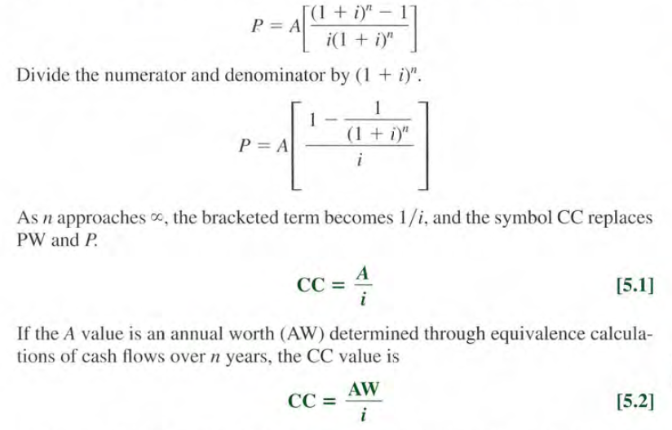

Formula to calculate Capitalized Cost
The formula to calculate CC is derived from the relation
P = A(P / A , i , n), where n = $∞$.

Slide 4


Mathematically, the amount A of new money generated each consecutive interest period for an infinite number of periods is,
A= = Pi = CC(i)

Slide 5
The cash flows (costs or receipts) in a capitalized cost calculation are usually of two types: recurring, also called periodic, and nonrecurring.
An annual operating cost of $50,000 and a rework cost estimated at $40,000 every 12 years are examples of recurring cash flows.
Examples of nonrecurring cash flows are the initial investment amount in year 0 and one-time cash flow estimates at future times, for example, $500,000 in royalty fees 2 years hence.

Slide 6
Procedure
Draw a cash flow diagram showing all nonrecurring (one-time) cash flows and at least two cycles of all recurring (periodic) cash flows.
Find the present worth of all nonrecurring amounts. This is their CC value.
Find the equivalent uniform annual worth (A value) through one life cycle of all recurring amounts. This is the same value in all succeeding life cycles. Add this to all other uniform amounts occurring in years 1 through infinity and the result is the total equivalent uniform annual worth (AW).
Divide the AW obtained in step 3 by the interest rate i to obtain a CC value.
Add the CC values obtained in steps 2 and 4.

Slide 7
Example 1:
The property appraisal district for Marin County has just installed new software to track residential market values for property tax computations. The manager wants to know the total equivalent cost of all future costs incurred when the three county judges agreed to purchase the software system. If the new system will be used for indefinite future, find the equivalent value (a) now and (b) for each year hereafter. The system has an installed cost of $150,000 and an additional cost of $50,000 after 10 years. The annual software maintenance contract cost is $5000 for the first 4 years and $8000 thereafter. In addition, there is expected to be a recurring major upgrade cost of $15,000 every 13 years. Assume that i = 5% per year for county funds.

